Slide 1


Exam 1 Preparation
ASEN 3728 Aircraft Dynamics
UNIVERSITY OF COLORADO BOULDER

Slide 2
Exam 1
Given in class on Tuesday, February 25
CLOSED book, open calculator (scientific is sufficient)
Can bring note sheet: one page front and back OR two pages one sided
Have entire class period
2-3 Numerical Problems (~20 pts), 1-2 True/False (5 pts)
Previous Exams posted on Canvas: Files -> Previous Exam 1s
Versions with and without solutions
Look at version w/o solution first
Review session on Monday night

Slide 3

Do u think I can skip studying since when we get a cheat sheet
nah because u still need to know which eqn to use

Slide 4
Topics to Study
[Not an exhaustive list: Exam covers all content up to the end of the quadrotor control discussion]
Notation and nomenclature
Symbols and words
Rotations and Euler angles
Vector derivatives
Aircraft state vector
Rigid body equations of motion
Quadrotor equations
Linearization
Derivatives (product, chain, quotient rules, trig functions present in EOM)
Eigenvalues and solutions to linear ODEs
Quadrotor controls

Slide 5
True / False Justification
Formality: Casual conversation < T/F Justification <= Mathematical Proof
Must be a logical argument that is
Clear: Each step should follow immediately from previous ones
Precise: Appropriate terms and symbols must be used correctly as defined in class, or a clear definition must be given
Complete: All relevant cases and possibilities must be accounted for
Correct: The justification must not contain any incorrect statements or logical steps
Concise: The justification should not be needlessly long
[Not graded, but useful in the real world: Insight and elegance – does the justification explain why the statement is true of false]

Slide 6
Justification Strategy
Write down relevant equations
Convince yourself whether the statement is true or false.
Write down your justification using words, equations, and/or numbers
If the statement is true, try to prove directly
If the statement is false, try to find a counterexample (or disprove directly)
Cross out any work that is not part of your justification

Slide 7
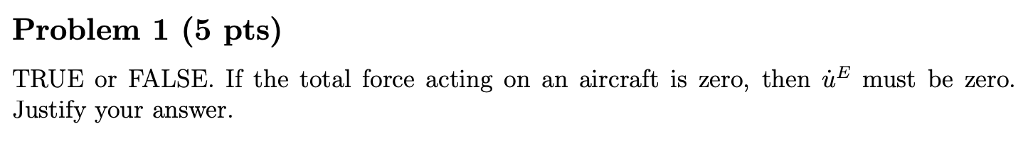
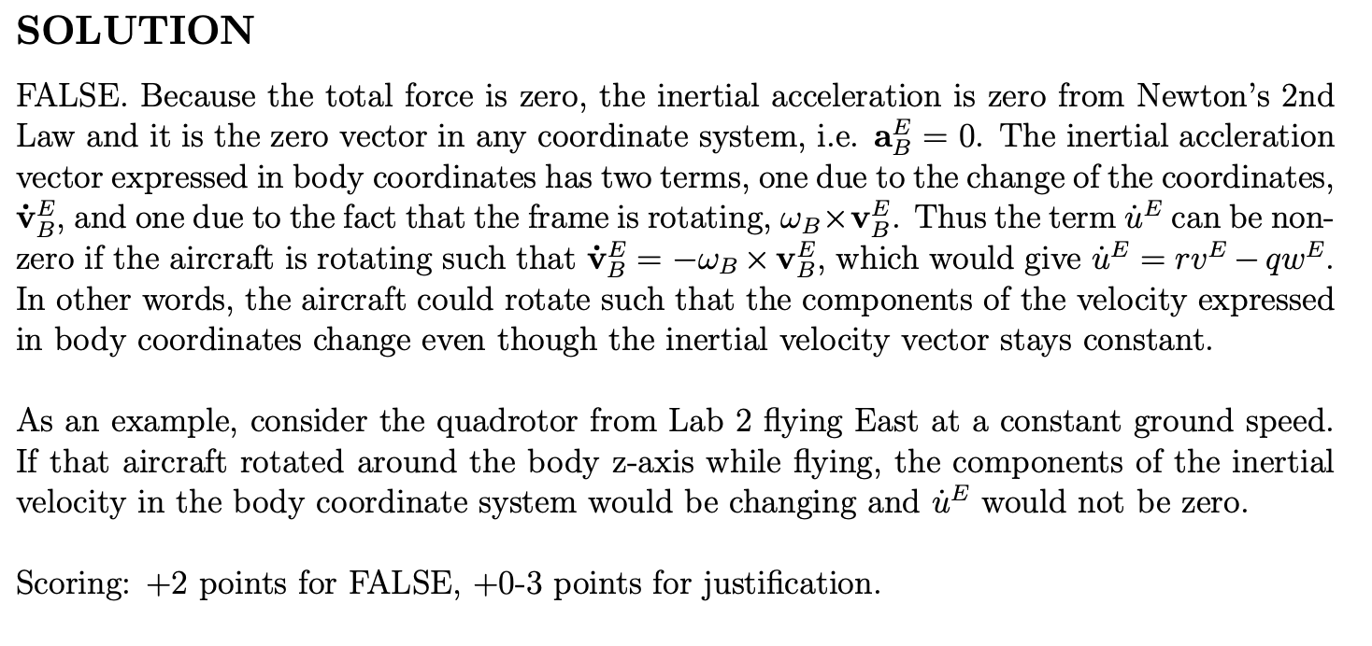
2021: Problem 1
(From a previous year, contains insight)

Slide 8
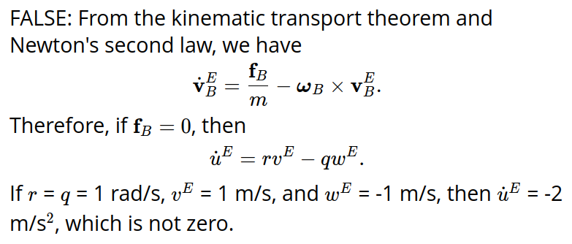
2021: Problem 1
Concise solution appropriate for exam:

Slide 9
2021: Problem 1
Biggest Issues:
Not recognizing that acceleration has two terms, one due to changing terms and one due to rotation.
Including irrelevant information. For example, wind has nothing to do with this problem but was mentioned multiple times.
Making incorrect statements. For example, the total force being zero does not mean X=Y=Z=0 (the aerodynamic force terms).
Not having a logical or clear explanation. Just giving an equation is not enough to provide a justification

